Slide 1
Incremental model – when to use
There are situations in which initial software requirements are reasonably well defined
Additionally, there may be compelling need to provide a limited set of software functionality to users quickly and then refine and expand on that functionality in later software releases
In such case you choose a process model that is designed to produce that software in increments

Slide 2
The incremental model
This is a combination of the linear sequential model and the iterative model.
The problem is broken into increments, and each increment is tackled as a linear sequence.
Early increments are stripped-down versions of the final product.
Incremental delivery focuses on the delivery of an operational product with each increment

Slide 3
The incremental model - example
For example, word-processing software developed using increments paradigm might deliver basic file management, editing, and document production functions in the first increment
Second increment: more sophisticated editing and document production capabilities
Third: spelling and grammer checking
Fourth: Advanced page layout

Slide 4
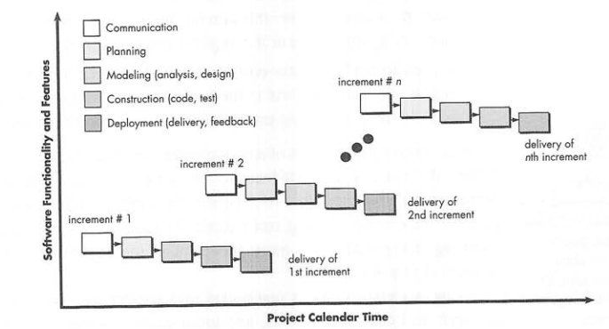
Incremental model
1st increment is often a core product, basic requirements are addressed
Planning for the next increment
Repeat until complete product is produced

Slide 5
Incremental model advantages
Early delivery is guaranteed
Progress of the whole project is not delayed if one of the resources is not available for part of it
Particularly useful when staffing is available for a complete implementation
Early increments can be implemented with fewer people

Slide 6
The Spiral model
IT couples the iterative nature of prototyping with the controlled and systematic aspects of the linear sequential model
Software is developed in a series of incremental releases
During the early releases, there may be just a paper model, but the system becomes increasingly more complete
This model keeps revisiting the system throughout its lifetime.

Slide 7
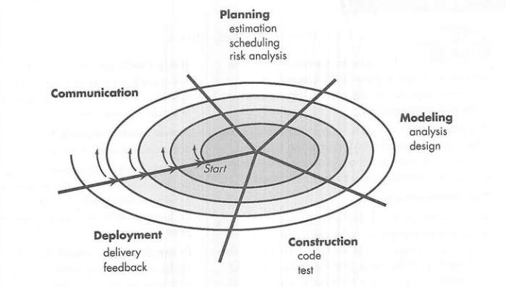
Spiral model details
Spiral model is divided into a number of framework activities, named as task regions.3-6 task regions. Each task region has its own task sets.

Slide 8
The Spiral model
The first circuit around the spiral might result in development of a product specification
Subsequent passes around the spiral might be used to develop a prototype
The following might progressively more sophisticated version of the software
Unlike other process models that end when software is delivered, spiral can adapt to apply throughout the life of s/w

Slide 9
Examples
Question 1
PUCIT consists of many departments like Administration, Accounts, Examination, Admission, Library, Computer Labs, Faculty Management, and Student Management etc. Every department has its own specific process and each department is using computer-based system to some extent. It is decided by the higher management that all the departments should be integrated under one system where they must work independently. Higher Management wants to see this system within this year. Risks, which can arise, should be accommodated implicitly keeping the time factor in mind
What Software Process Model would you choose and why? State your assumptions clearly, if any, and give logical reasons in support to your answer.

Slide 10
Examples
Solution
Stated Facts:
Assumptions
Selected Process Model
Reasoning for selecting the Process Model
Project Working

Slide 11
Examples
Solution
Stated Facts:
System is decomposed in different components
Every Component is automated to some extent but running stand alone
Management wants a system under which all components will run independently
Time constraint is there
Risk will be accommodated implicitly

Slide 12
Examples
Solution
Assumptions:
As components are automated to some extent, even then these components will be restudied and analyzed, so that these can be run under one system independently.
There will be system level interface to access components but rights of each user will be specified and restricted as per user policy.
Team resources are sufficient available through which parallel development can occur.
Since components are already automated to some extent, so historical data will certainly help us to understand the components. Similarly risks occurrence will be reduced.

Slide 13
Examples
Solution
Selected Process Model: RAD Model
Reasons
As the system is already decomposed into components, so it will be feasible for us to make RAD team for each component as we have sufficient human resources.
Time constraint is there, RAD approach will suit us to complete the project with in specified time.
RAD model uses the modeling approach in which already done work can be accommodated easily. Further more through modeling we can easily understand the already done work and can suggest further recommendations by using pictorial form of modeling in understandable and efficient way.

Slide 14
Examples
Solution
Reasons (continue…)
Some work has already been done on the components, so it will be quiet easy for us to understand the requirements, which will be a support for us to use the linear sequential model’s elements of RAD model.
Since we are using RAD Model, so we will save effort, time, and finance involved in the project.

Slide 15
Examples
Solution
Project Working
At the start of project, one team will immediately develop the system level interface so that each component can be plugged in that system level interface. Other teams will carry on their work on respective components simultaneously. When system level interface will be prepared and architecture of the software will be finalized, it will be shared to all RAD teams, and each team will follow the system level constraints while developing their respective module. When all teams will complete their work, all components will be integrated and system level testing will be carried out.

Slide 16
Questions?

